Slide 1

Your Introduction card
Name: 你的名字
Contact email: 电子邮件地址
Experience as a conductor: 经验导体
What you hope to learn from this course: 你希望是什么这门课程的学习？
Send info and any questions to tholmchor@gmail.com
Notes:
Hand out 3 x 5 cards, or, ask them to send info via email
Bring computer, connection cable, handout packet, syllabus, Tom’s hard copy of PP

Slide 2
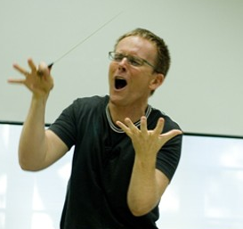
Foundations in conducting
Three sessions
  #1 Tuesday July 9, 7-10 pm
  #2 Saturday July 13, 6-9 pm
  #3 Tuesday July 16, 7-10 pm
This class
  Presentation of basic techniques
  Much practice in class
  Optional assignments to practice between class times
  Last class: bring your conducting problems
Notes:
Begin with q’s and handout: their contact email, experience conducting, and what they hope to learn from this course

Slide 3
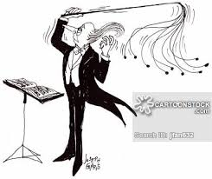
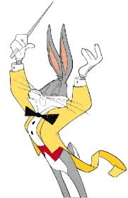
Topics and order
Posture, arm/hand positions
4- and 3-beat patterns
Preparatory gestures
Articulations: legato, staccato, etc.
2- and 1-beat patterns
Dynamic changes gradual: right hand & left hand
Dynamic changes subito
Fermatas

Slide 4
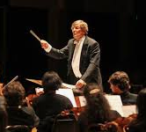
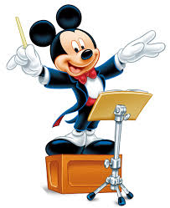
Topic order (cont.)
Right-hand cues
Left-hand cues
Compound meters
Divided patterns
Changing meters
Tempo changes gradual
Tempo changes subito

Slide 5
Topic order (cont.)
Basic principles of rehearsal
  KNOW your score
  Planning and review
  Rehearsal pyramid
  Prescription vs description
  What does the choir need from you NOW?
Optional topics (if interest and time)
  Score analysis: Foreground, middle ground, background
  Choral tuning aspects
    Unified vowels
    Overtone series and ‘just’ intonation

Slide 6

Topic order (cont.)
Optional topics (cont.)
  Voice-building exercises
    Passaggio
    Resonance
    Dynamics
    Color
  Singer placement within section
  Sectional placement within choir
Showing the music: moving beyond pitch and rhythm
  Breaking the rules with a purpose
  Less is more, more is less
  Highlighting the surprises

Slide 7
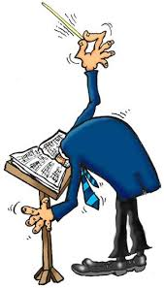
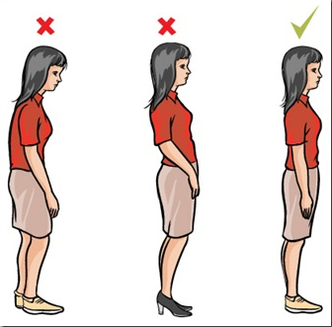
Posture
姿势
Conductor’s posture…a model for good singer’s posture
  Tall spine
  Shoulders back
  Tail tucked in

Slide 8
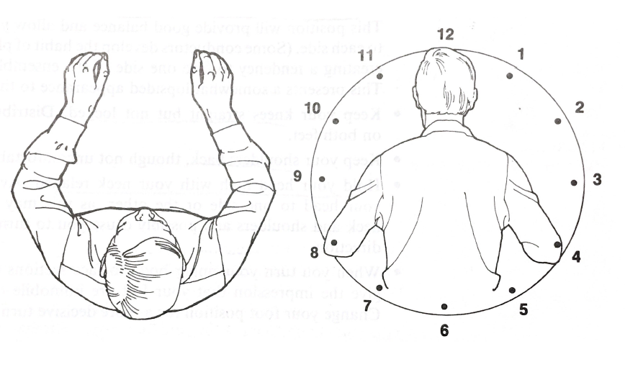
Arm and hand position
臂和手的位置

Slide 9
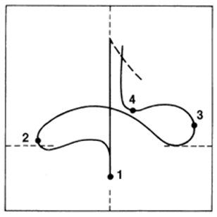
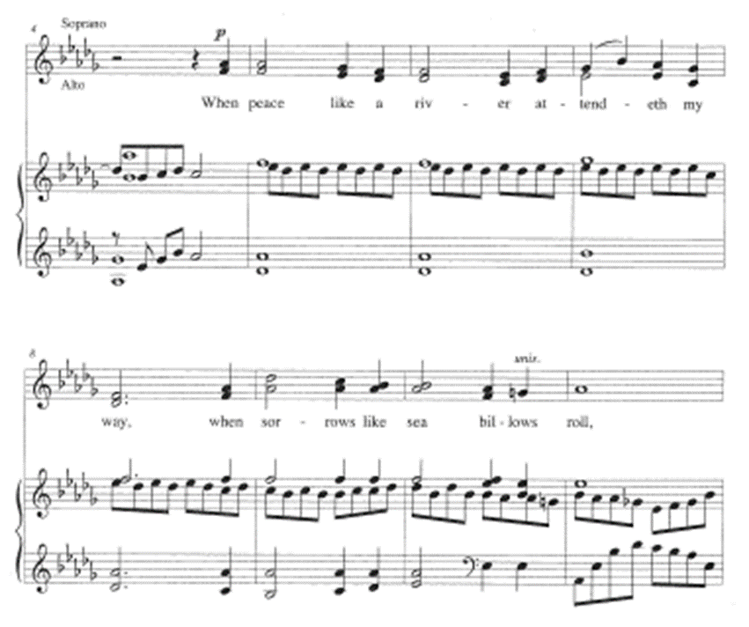
The basic four-beat pattern
Notes:
Also show on white board, including horizontal and vertical planes

Slide 10
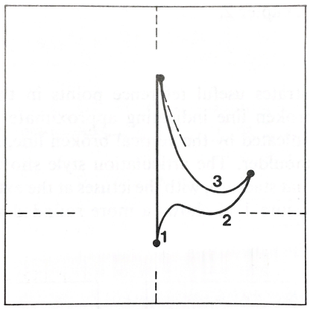
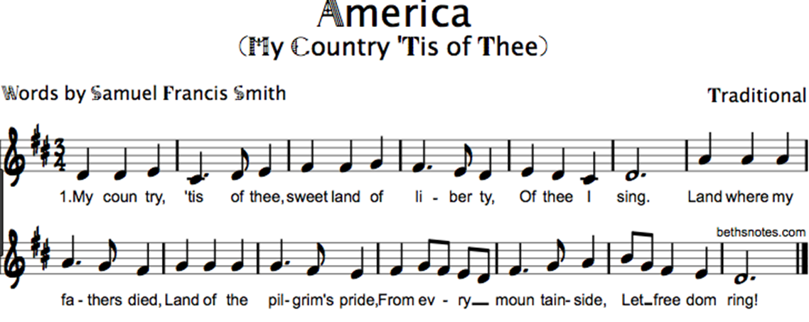
The Three-beat pattern

Slide 11

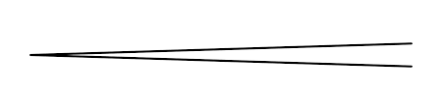


The Preparatory gesture
What should it show?
It should show…
  Exact beginning of the first tone
  Dynamic level
  Articulation: staccato—legato—marcato
  Tempo
Notes:
On white board, feedback from opening question: what should prep show?
Eye contact, hold, clear first gesture accompanied by breath

Slide 12

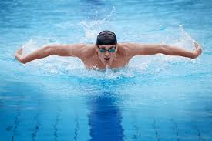
Prep gesture components
Eye contact
Music already playing inside
Command position: complete stop before prep
Clear gesture showing…
  Tempo
  Dynamic
  Articulation
With visible breath
‘Prep’ gesture = beat prior to initial beat

Slide 13
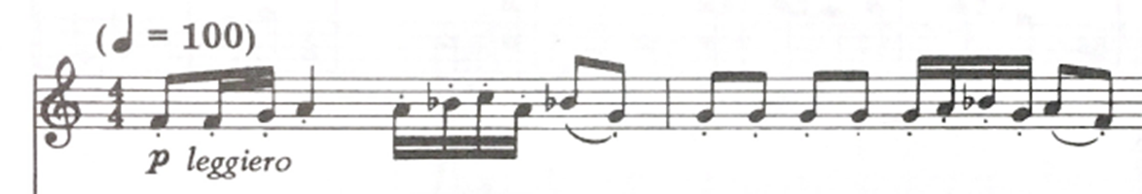
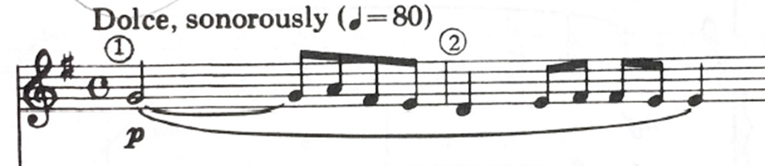
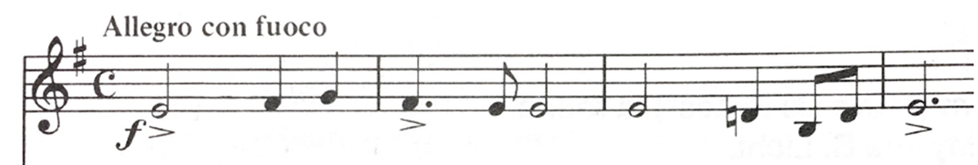
Practice preps

Slide 14
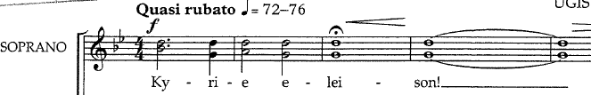

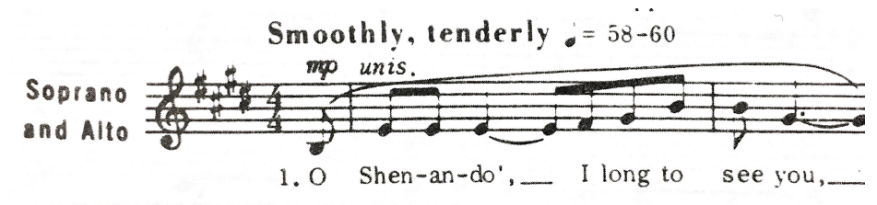
More practice preps

Slide 15
A few video clips of preps
https://youtu.be/gxxHr4Bz5No
https://youtu.be/unkrkteJN-0?t=23s
https://youtu.be/ryZTs18yUAo?t=22s
Notes:
Watch each and evaluate for: eye contact, hold position, clarity of intent, tempo
First clip shows unclear prep and no stop/command position
Second is Phillip Brunelle: what IS he showing?
Fourth clip shows preps at different tempo than piece

Slide 16
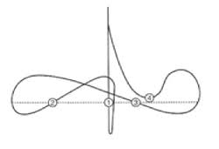
Articulation types: legato
Legato:
  all connected, smooth movement
  Wrist leads slightly
Notes:
Practice handout exercise Excerpt 1-1 and 2-2

Slide 17
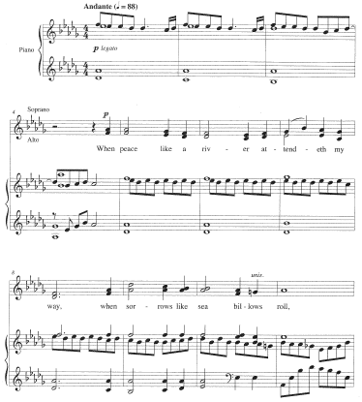

Slide 18
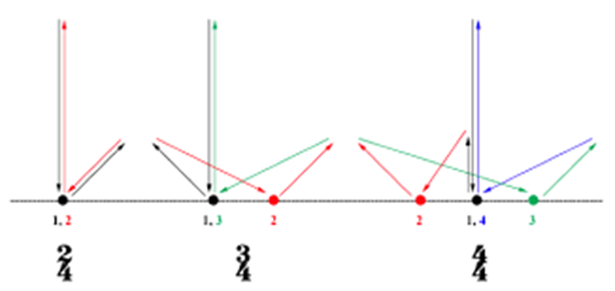
Articulation types: staccato
Staccato:
  Not connected, quick movement, upbrupt stop
  Tip of beat “flicks up” on ictus

Slide 19
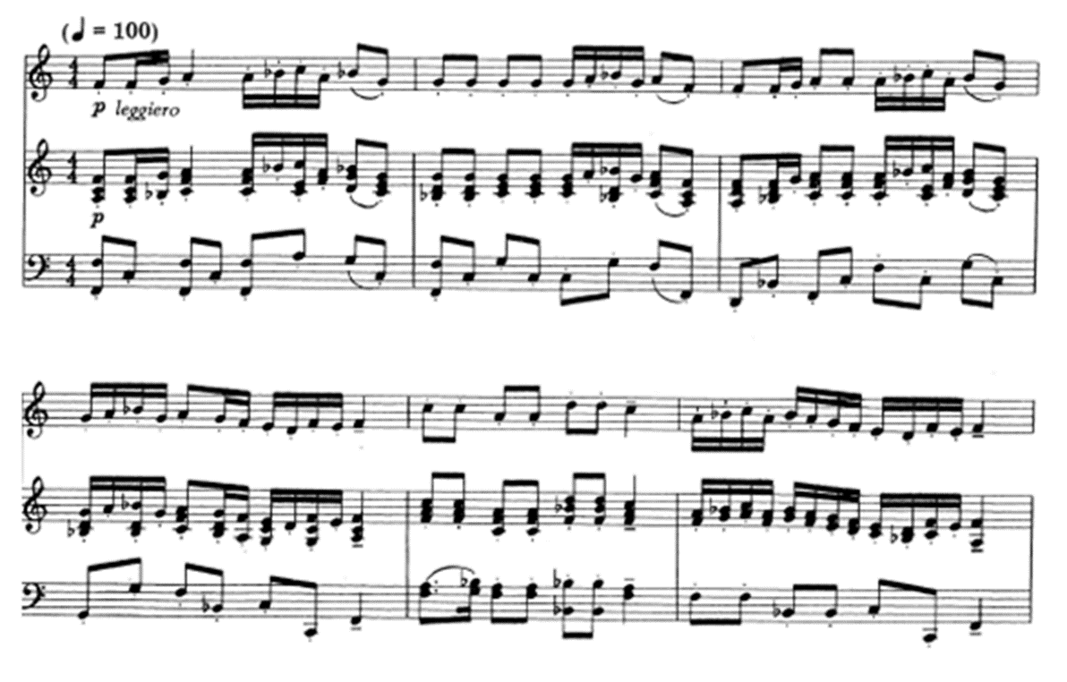

Slide 20
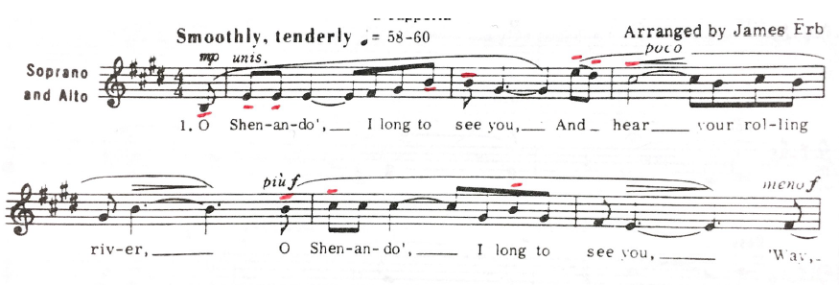
Articulation types: tenuto
Tenuto:
  Heavily connected, horizontal motion
  Wrist leads, fingers follow

Slide 21
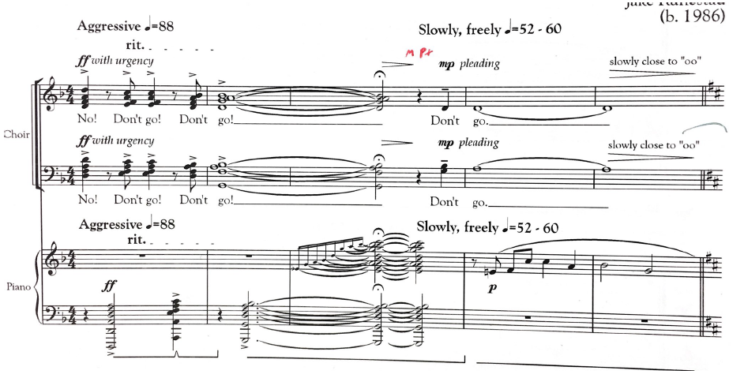
Articulation types: marcato
Marcato:
  Heavy weight, quick but short rebound

Slide 22
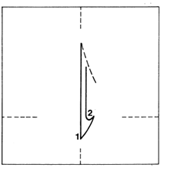

Two-beat patterns
staccato/marcato
Notes:
Note horizontal plane: important for not getting lost. Marching band gesture

Slide 23
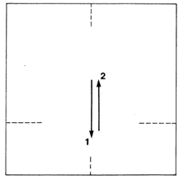

Two-beat patterns
Fast tempos, dry articulation, wrist only

Slide 24
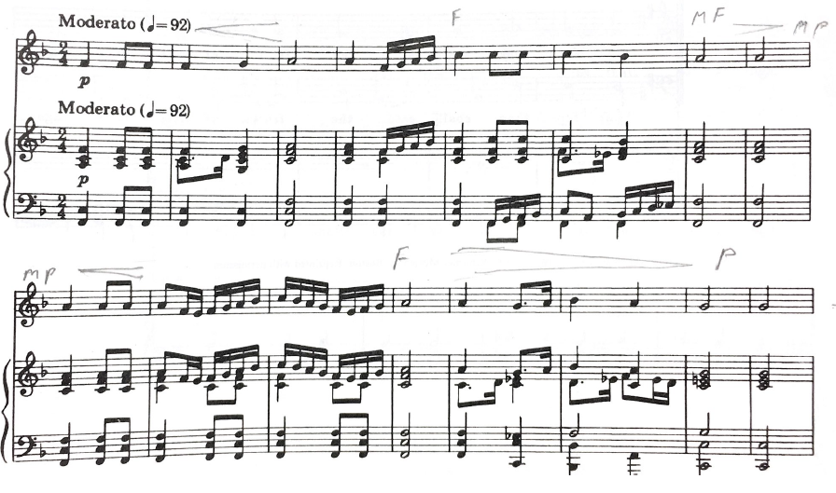
2-beat: slow, legato

Slide 25
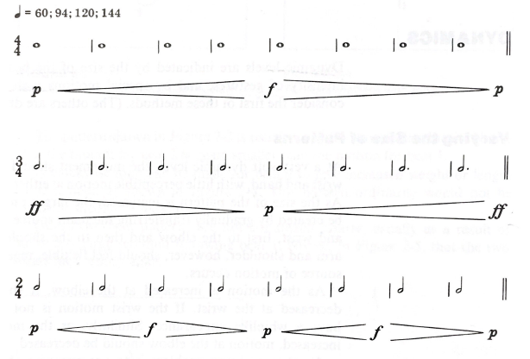


Right-hand dynamics: gradual
Notes:
Three joints: wrist, elbow, shoulder

Slide 26
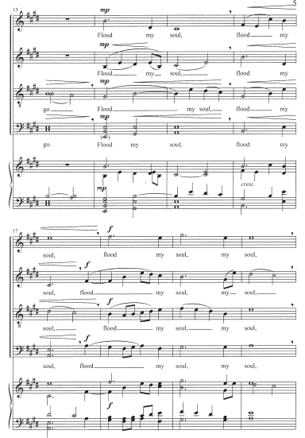

Slide 27
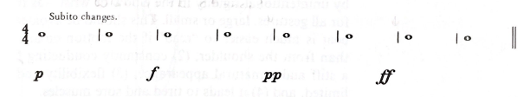
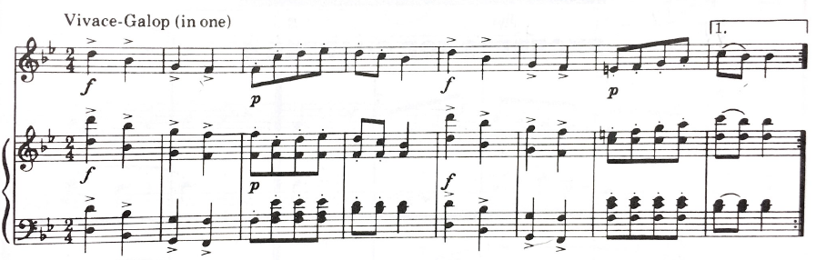
Right-hand dynamics: subito
Notes:
Subito: Where does the change occur?

Slide 28
Left-hand dynamics: gradual
Notes:
Three joints: wrist, elbow, shoulder

Slide 30
Left-hand dynamics: subito
Notes:
Subito: Where does the change occur?

Slide 31




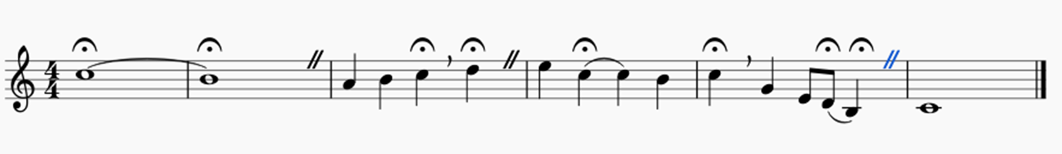
Fermatas
Three types
  Hold + full stop (caesura):
  Hold + No Breath and continue:
  Hold + cut-off and continue:
  (end of cut = start of prep)
Notes:
Also: 1-2-3-4 1-2-3-4 1-2-3-4 1-2-3-4 on white board, with moving fermata

Slide 32
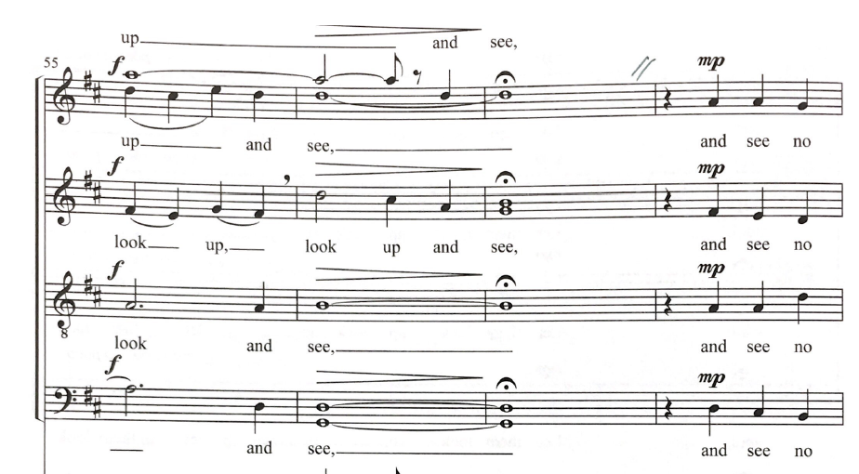
Fermata I: Hold + full stop (caesura)

Slide 33
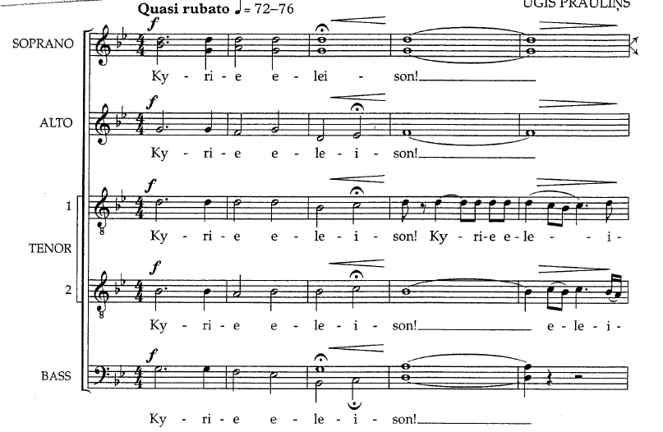
Fermata II: hold but no break

Slide 34
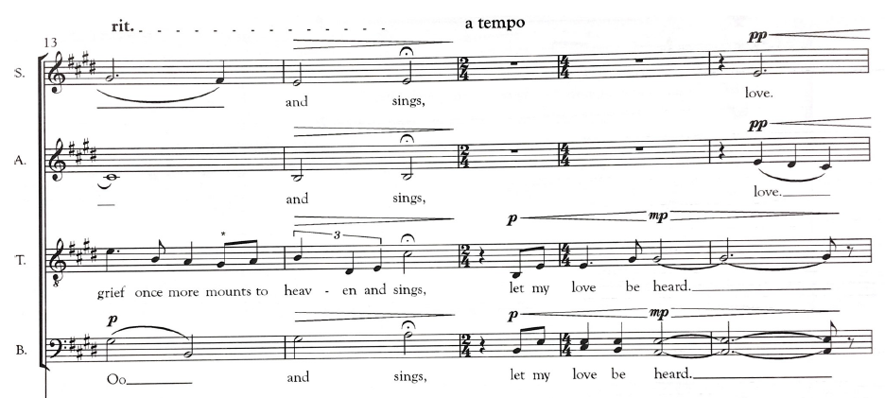
Fermata III: hold + breath in tempo, no pause

Slide 35

Fermatas: three-in-one exercise

Slide 36


Right-hand cues
Eye contact
Minimize two beats ahead
Prep one beat ahead

Slide 37
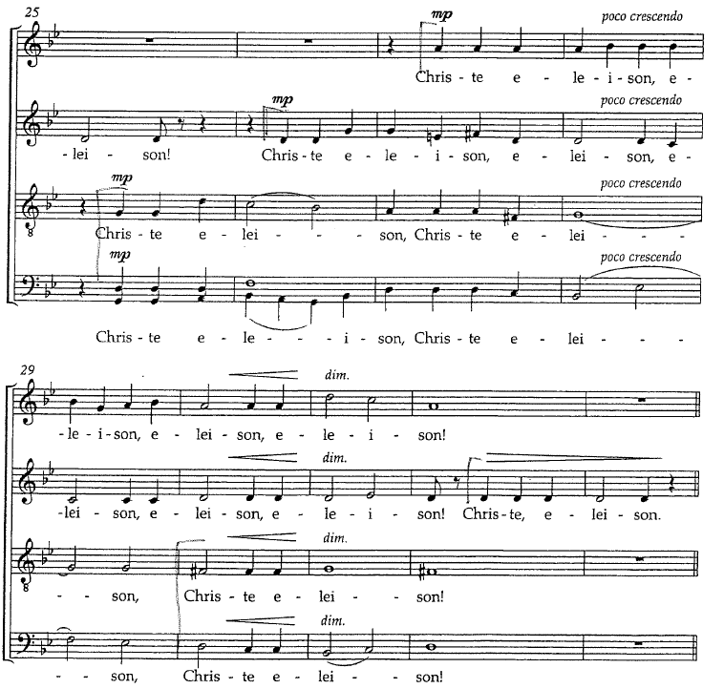

Slide 38
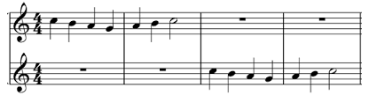

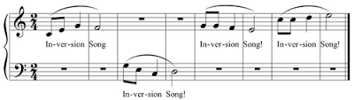
Left-hand cues
  Eye contact
  Left hand at attention two or more beats ahead of cue
  Begin prep one beat early, including breath
  Cue arrives on ictus of new entrance

Slide 39
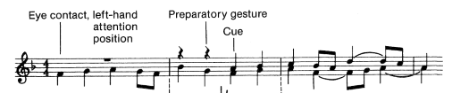
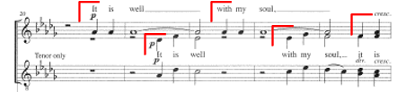
Left-hand cues in real music

Slide 41
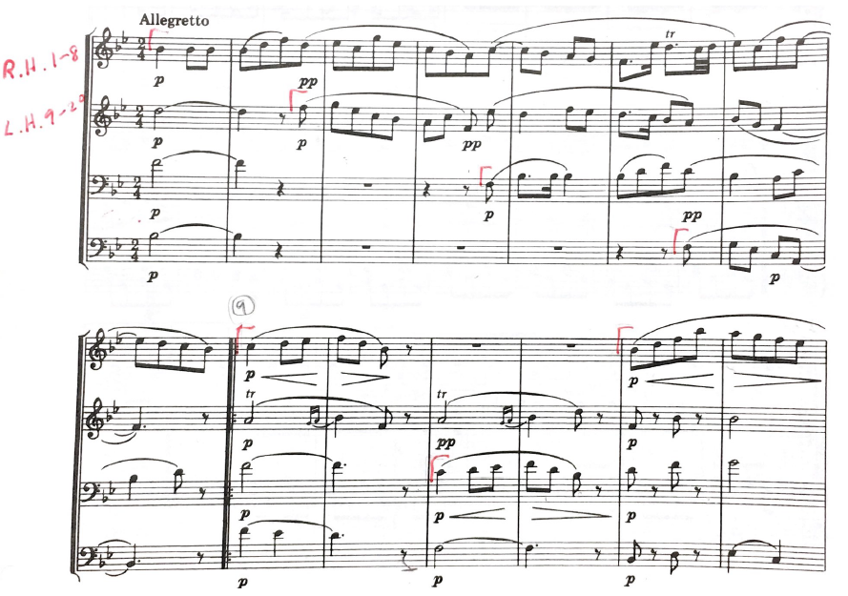
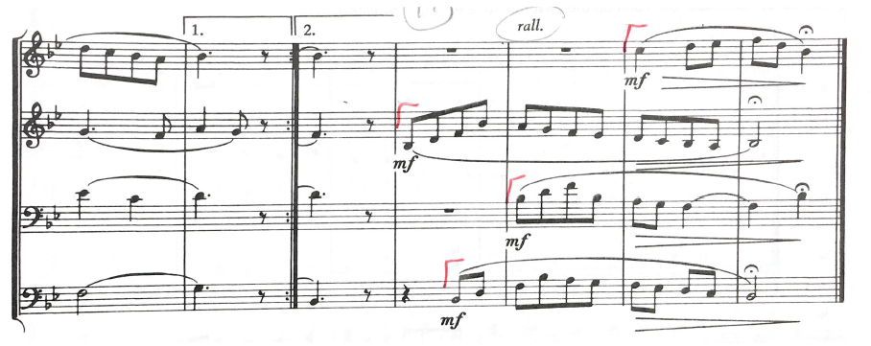
R.H & L.H. cue challenge!

Slide 42
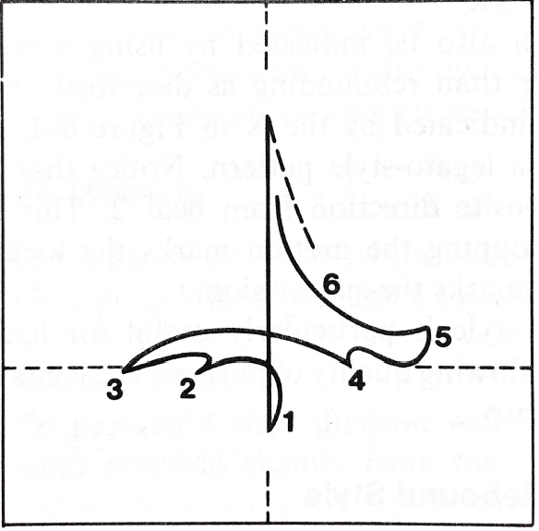
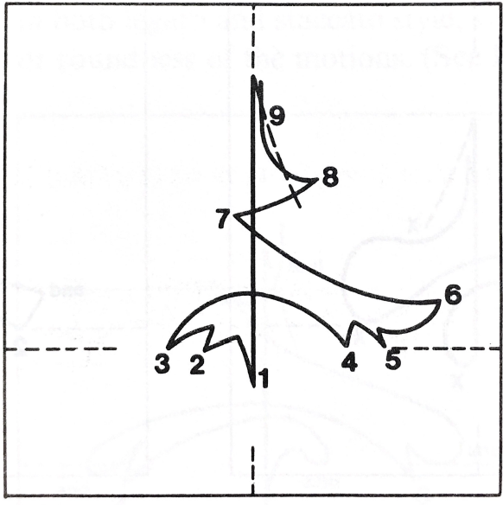
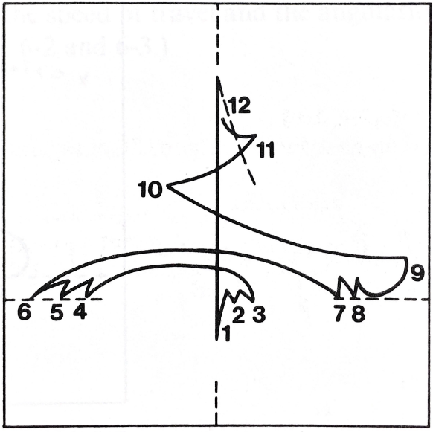
Compound meters
6/8
9/8
12/8

Slide 43
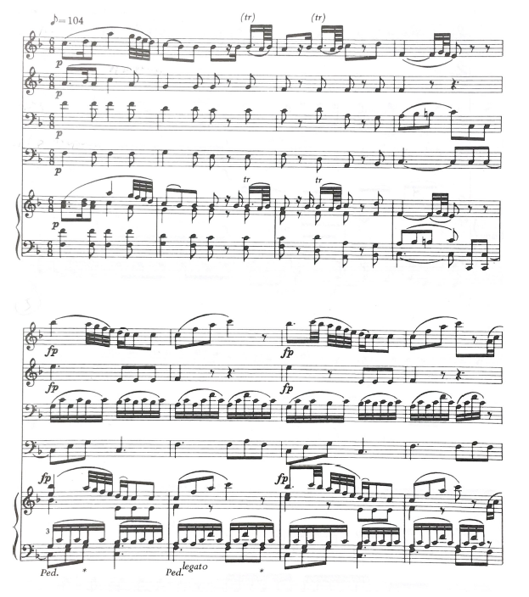


Slide 44
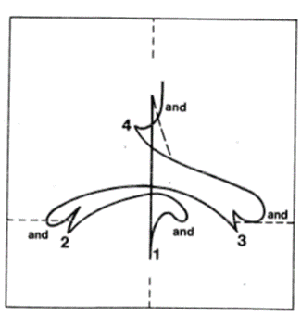
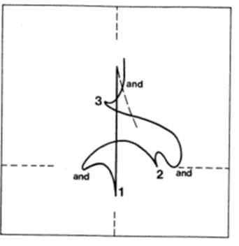
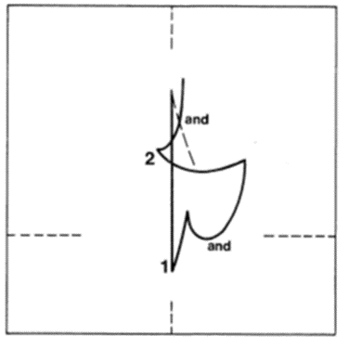
Divided meters
4/4
3/4
2/4

Slide 45



Slide 46


Slide 47


Changing meters

Slide 48



Slide 49



Tempo changes: gradual

Slide 50

Tempo changes: sudden

Slide 52
Rehearsal paradigm
Emotional/intellectual ownership
Expressive nuance
Text
Balance
Rhythm/intonation
Intonation/rhythm

Slide 53


Basic principles of rehearsal
KNOW the score, every part, every phrase, color

Slide 54



Slide 55



Slide 56



Slide 57



Slide 58
Optional topics if time/interest
Score analysis: foreground, middle ground, background
Choral tuning
  Vowels
  Overtone series and “just” vs “equal” tuning
Voice-building exercises
  Resonance
  Dynamics
  Passaggio
  Color
Notes:
LP #7

